Slide 2
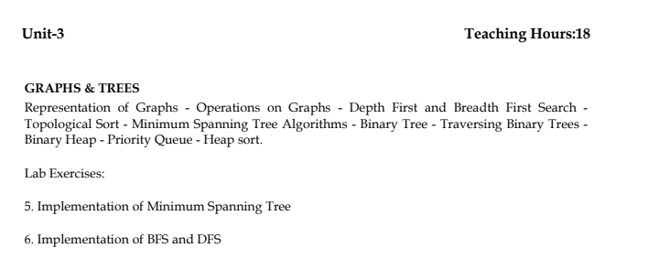
Agenda

Slide 3
Tree - Terminology
In linear data structure data is organized in sequential order and in non-linear data structure data is organized in random order.
A tree is a very popular non-linear data structure used in a wide range of applications. A tree data structure can be defined as follows
Tree is a non-linear data structure which organizes data in hierarchical structure and this is a recursive definition.
Tree data structure is a collection of data (Node) which is organized in hierarchical structure recursively

Slide 4
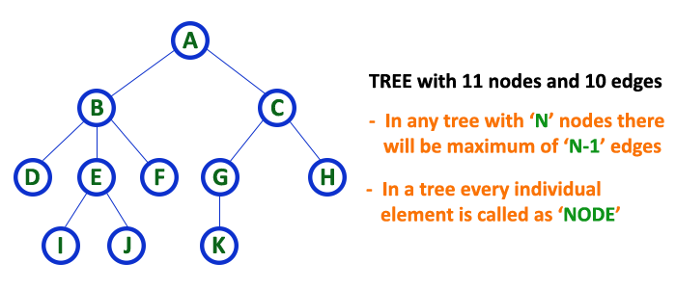
Node
In tree data structure, every individual element is called as Node. Node in a tree data structure stores the actual data of that particular element and link to next element in hierarchical structure.
In a tree data structure, if we have N number of nodes then we can have a maximum of N-1 number of links.

Slide 5
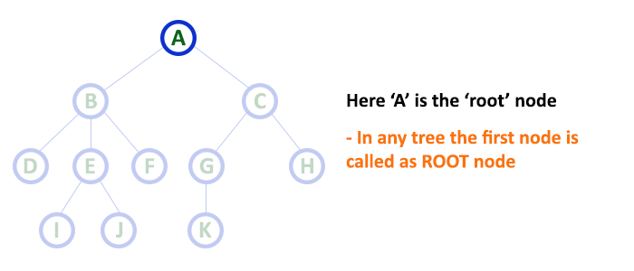
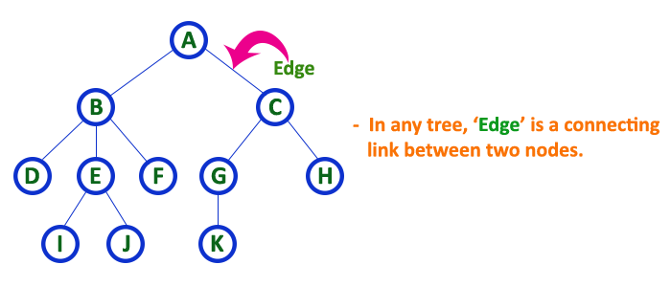
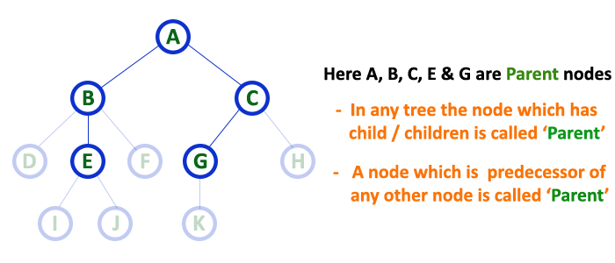
Root
Parent
Edge

Slide 6
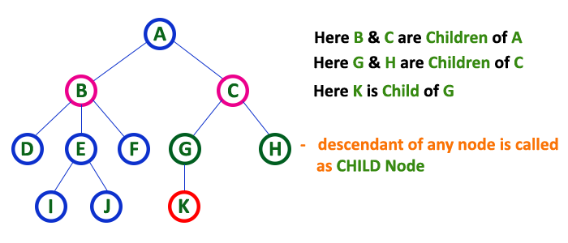
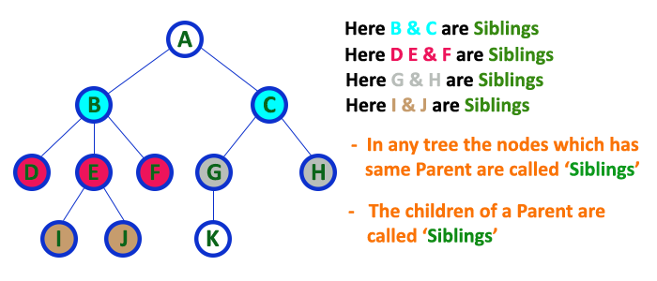
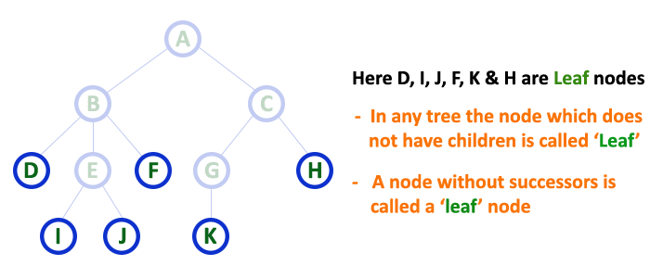
Child
Siblings
Leaf

Slide 7
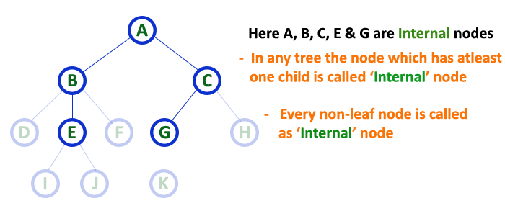
Internal Nodes
nodes other than leaf nodes are called as Internal Nodes. The root node is also said to be Internal Node if the tree has more than one node. Internal nodes are also called as 'Non-Terminal' nodes.

Slide 8
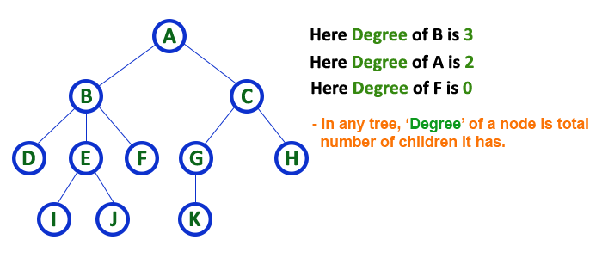
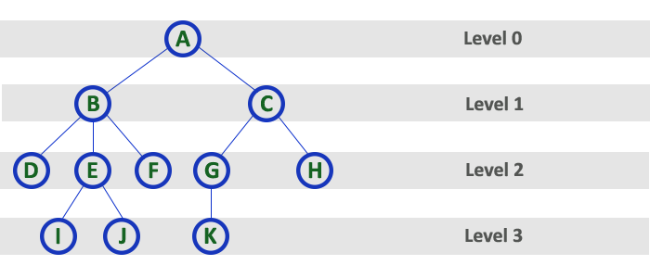
Degree
Level

Slide 9
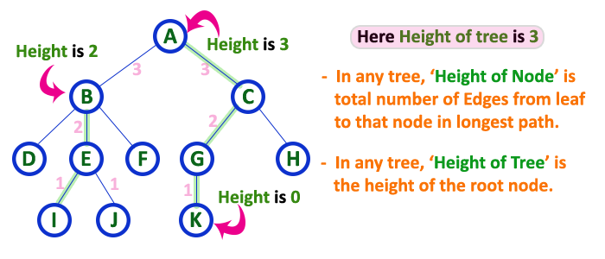
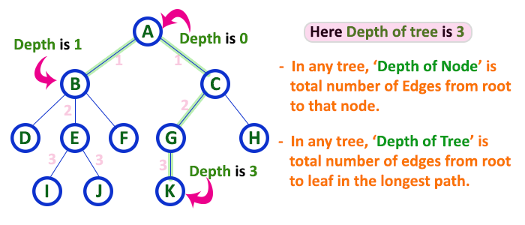
Height
Depth

Slide 10
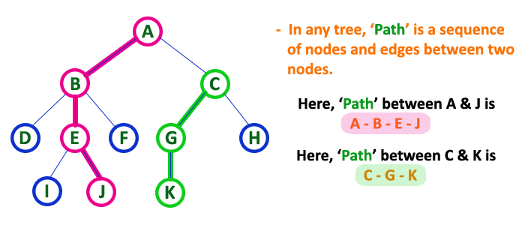
The sequence of Nodes and Edges from one node to another node is called as PATH between that two Nodes.
Length of a Path is total number of nodes in that path. In below example the path A - B - E - J has length 4.

Slide 11
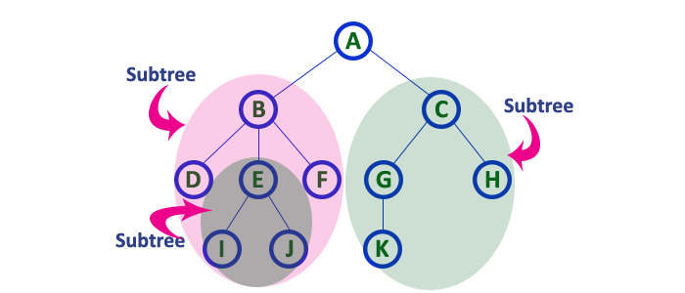
Each child from a node forms a subtree recursively. Every child node will form a subtree on its parent node.

Slide 12
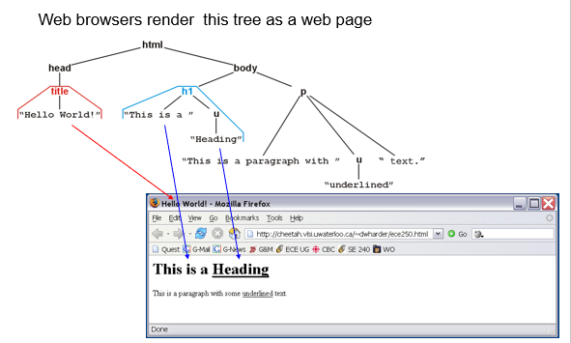

Slide 13
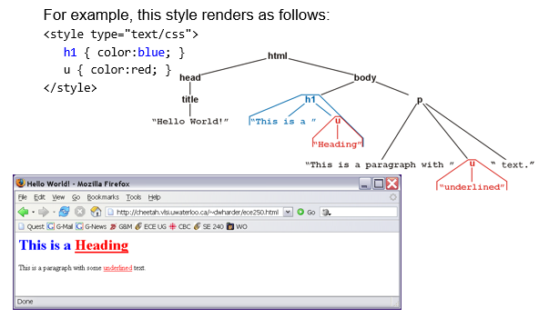

Slide 14
Tree Representation
A tree data structure can be represented in two methods. Those methods are as follows...
List Representation
Left Child - Right Sibling Representation

Slide 15
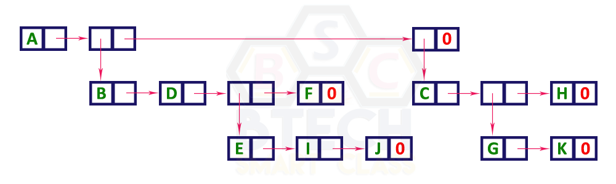
List Representation
Two types of nodes one for representing the node with data called 'data node' and another for representing only references called 'reference node’.
Start with a 'data node' from the root node in the tree. Then it is linked to an internal node through a 'reference node' which is further linked to any other node directly. This process repeats for all the nodes in the tree.

Slide 16
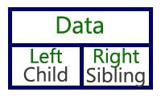
Left Child - Right Sibling Representation
A list with one type of node which consists of three fields namely Data field, Left child reference field and Right sibling reference field.
Data field stores the actual value of a node, left reference field stores the address of the left child and right reference field stores the address of the right sibling node.
Every node's data field stores the actual value of that node. If that node has left a child, then left reference field stores the address of that left child node otherwise stores NULL. If that node has the right sibling, then right reference field stores the address of right sibling node otherwise stores NULL.

Slide 17
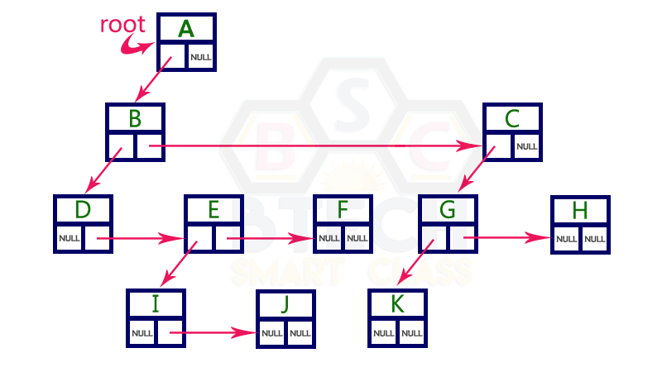
Left Child - Right Sibling Representation

Slide 18
Binary Tree
In a normal tree, every node can have any number of children. A binary tree is a special type of tree data structure in which every node can have a maximum of 2 children. One is known as a left child and the other is known as right child.
In a binary tree, every node can have either 0 children or 1 child or 2 children but not more than 2 children.
A tree in which every node can have a maximum of two children is called Binary Tree.

Slide 19
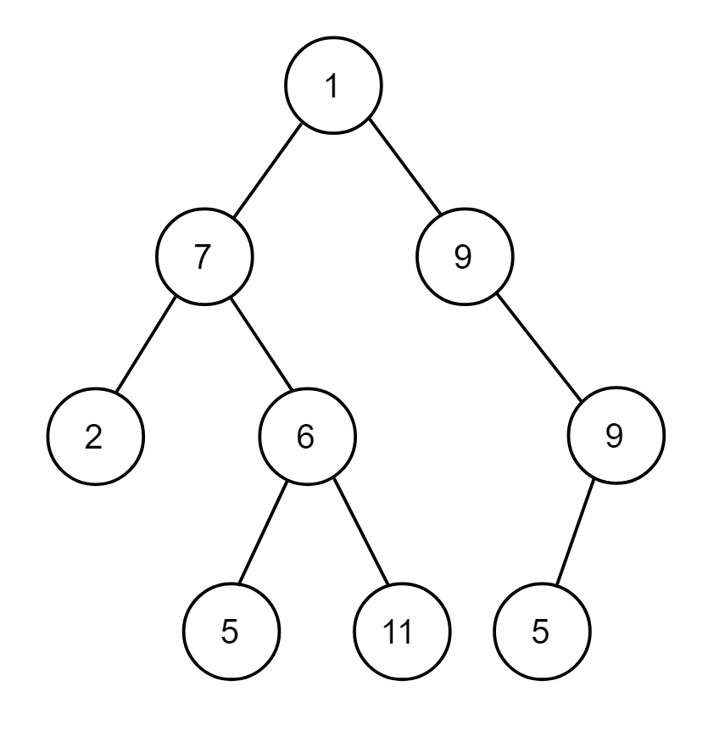
Binary Tree
A tree in which every node can have a maximum of two children is called Binary Tree.

Slide 20
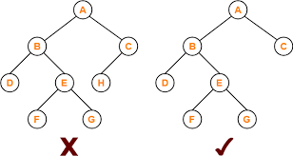
Strictly Binary Tree
A binary tree in which every node has either two or zero number of children is called Strictly Binary Tree
Strictly binary tree is also called as Full Binary Tree or Proper Binary Tree or 2-Tree

Slide 21
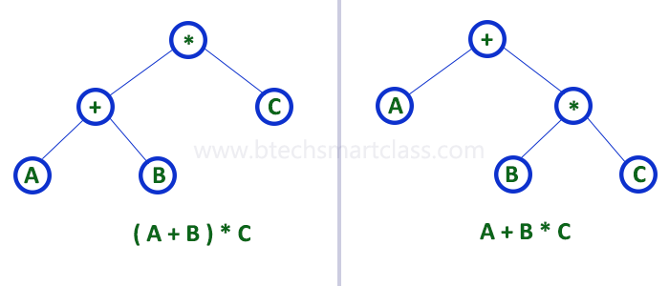
Strictly binary tree data structure is used to represent mathematical expressions.

Slide 22
Complete Binary Tree
In a binary tree, every node can have a maximum of two children. But in strictly binary tree, every node should have exactly two children or none and in complete binary tree all the nodes must have exactly two children and at every level of complete binary tree there must be 2^{level} number of nodes.
For example at level 2 there must be 2² = 4 nodes and at level 3 there must be 2³ = 8 nodes.

Slide 23
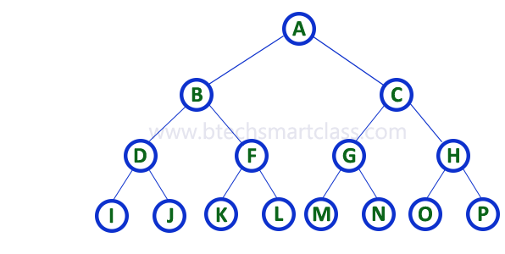
Complete Binary Tree
A binary tree in which every internal node has exactly two children and all leaf nodes are at same level is called Complete Binary Tree.
Complete binary tree is also called as Perfect Binary Tree

Slide 24
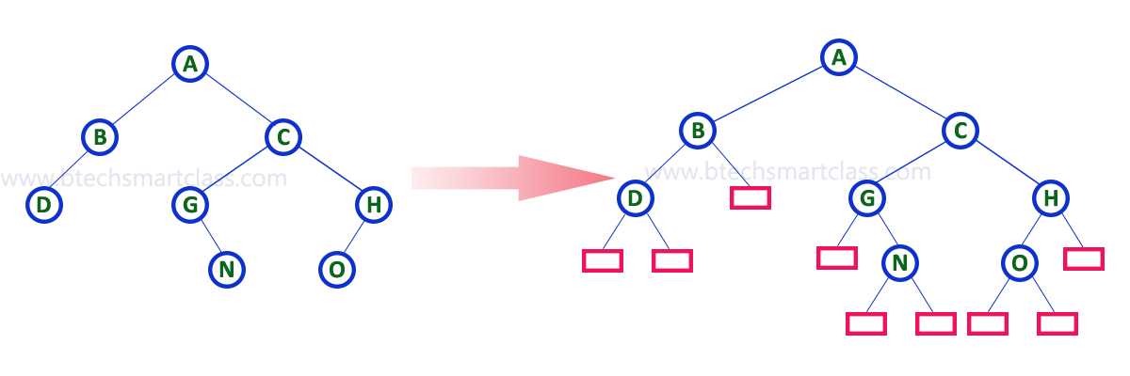
Extended Binary Tree
A binary tree can be converted into Full Binary tree by adding dummy nodes to existing nodes wherever required.
The full binary tree obtained by adding dummy nodes to a binary tree is called as Extended Binary Tree.

Slide 25
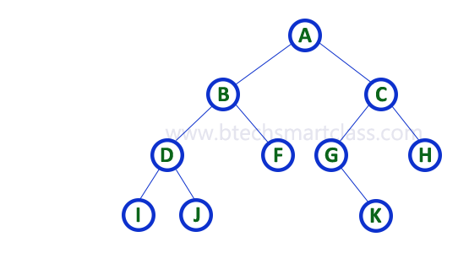
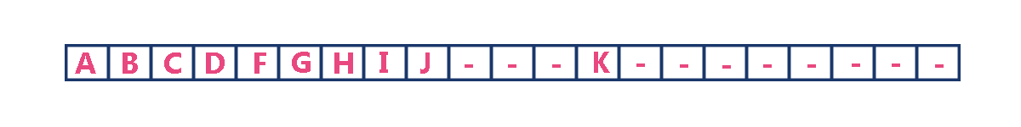
Binary Tree Representation
Binary tree data structure is represented using two methods. Those methods are as follows...
Array Representation
Linked List Representation

Slide 26

Linked List Representation of Binary Tree
Double linked list to represent a binary tree. In a double linked list, every node consists of three fields. First field for storing left child address, second for storing actual data and third for storing right child address.
In this linked list representation, a node has the following structure...

Slide 27
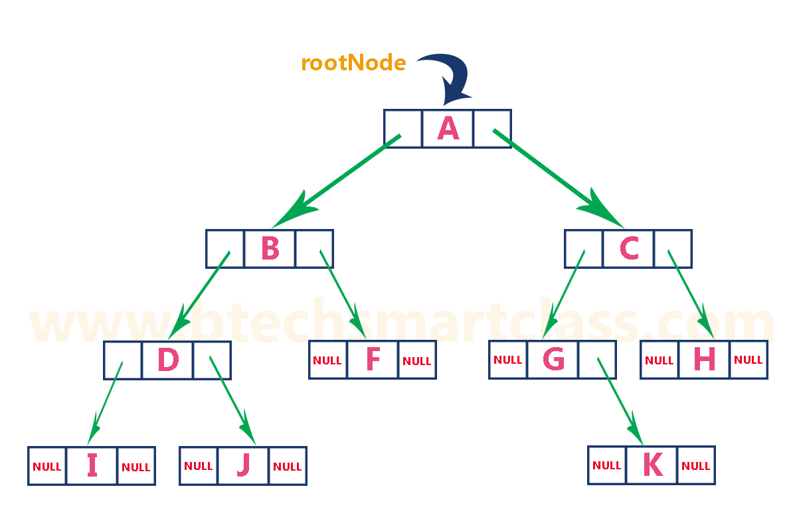
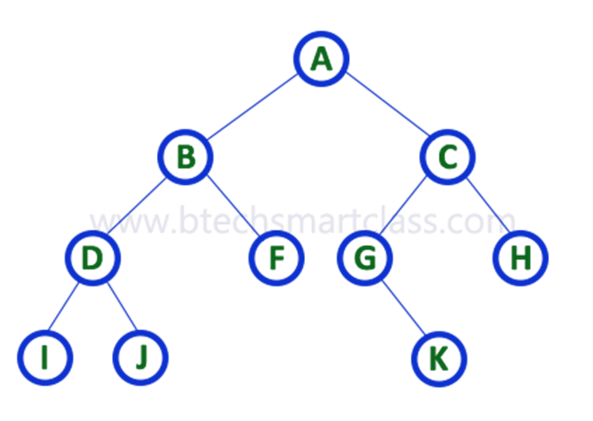
Linked List Representation of Binary Tree

Slide 28
Binary Heap
Heap data structure is a complete binary tree that satisfies the heap property, where any given node is
always greater than its child node/s and the key of the root node is the largest among all other nodes. This property is also called max heap property.
always smaller than the child node/s and the key of the root node is the smallest among all other nodes. This property is also called min heap property.

Slide 29
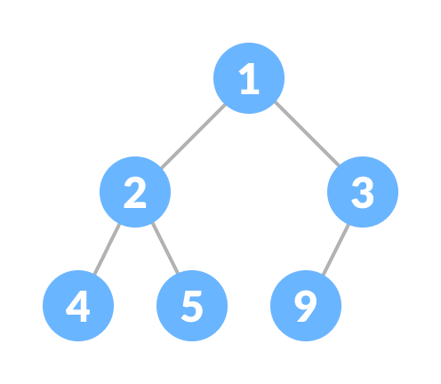
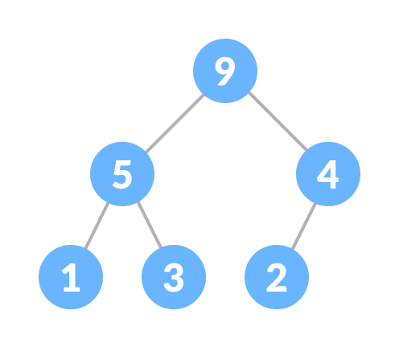
Binary Heap

Slide 30
Priority Queue
A priority queue is a special type of queue in which each element is associated with a priority value. And, elements are served on the basis of their priority. That is, higher priority elements are served first.
However, if elements with the same priority occur, they are served according to their order in the queue.

Slide 31
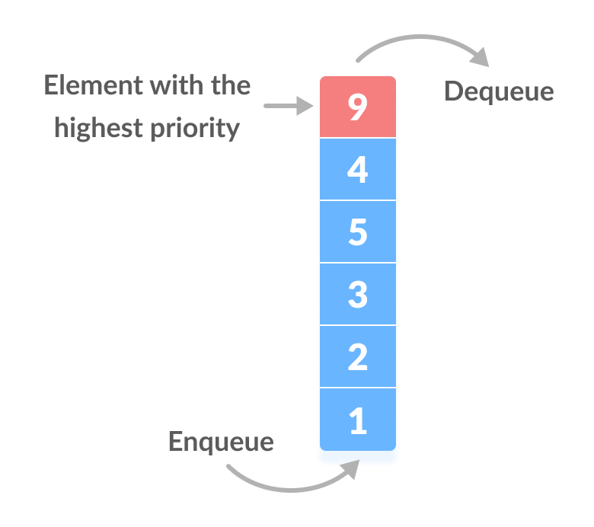
Assigning Priority Value
Generally, the value of the element itself is considered for assigning the priority.
For example, The element with the highest value is considered the highest priority element. However, in other cases, we can assume the element with the lowest value as the highest priority element.
We can also set priorities according to our needs.

Slide 32
Difference between Priority Queue and Normal Queue
In a queue, the first-in-first-out rule is implemented whereas, in a priority queue, the values are removed on the basis of priority. The element with the highest priority is removed first.
In a priority queue, each element has a priority value associated with it. When you add an element to the queue, it is inserted in a position based on its priority value.
For example, if you add an element with a high priority value to a priority queue, it may be inserted near the front of the queue, while an element with a low priority value may be inserted near the back.

Slide 33
Heapify
Heapify is the process of creating a heap data structure from a binary tree. It is used to create a Min-Heap or a Max-Heap.

Slide 34
Heap Sort
Heap sort is one of the sorting algorithms used to arrange a list of elements in order. Heapsort algorithm uses one of the tree concepts called Heap Tree. In this sorting algorithm, we use Max Heap to arrange list of elements in Descending order and Min Heap to arrange list elements in Ascending order.

Slide 35
Algorithm
Step 1 - Construct a Binary Tree with given list of Elements.
Step 2 - Transform the Binary Tree into Min Heap.
Step 3 - Delete the root element from Min Heap using Heapify method.
Step 4 - Put the deleted element into the Sorted list.
Step 5 - Repeat the same until Min Heap becomes empty.
Step 6 - Display the sorted list.

Slide 36
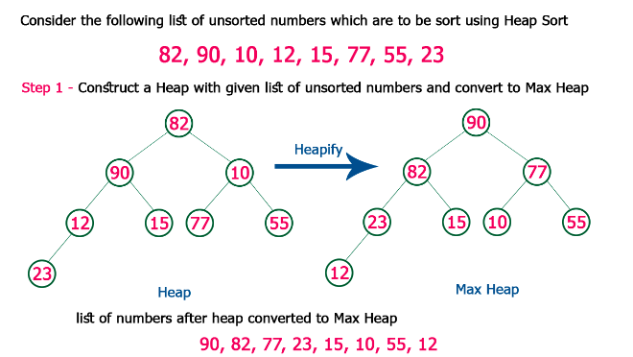

Slide 37
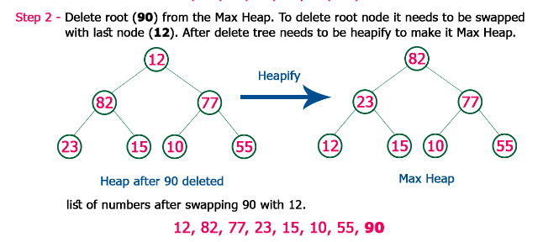

Slide 38
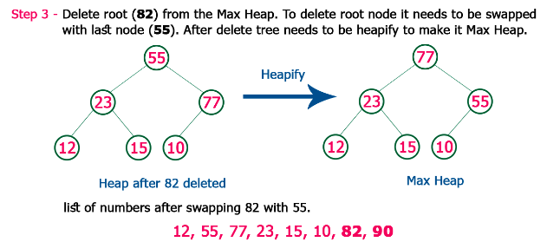

Slide 39
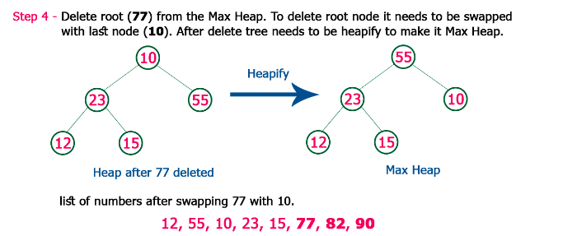

Slide 40
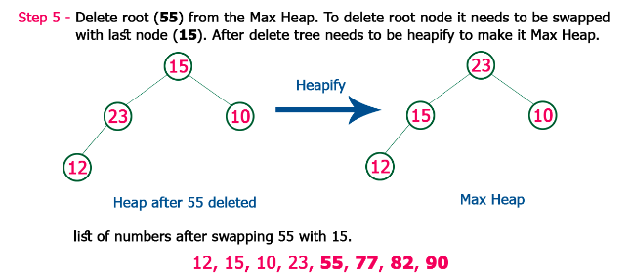

Slide 41
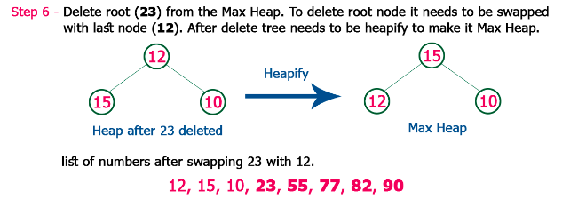

Slide 42
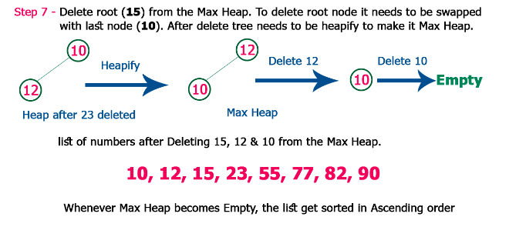

Slide 43
Summary
Merge and heap works in a similar way (O n log n)

